Slide 1
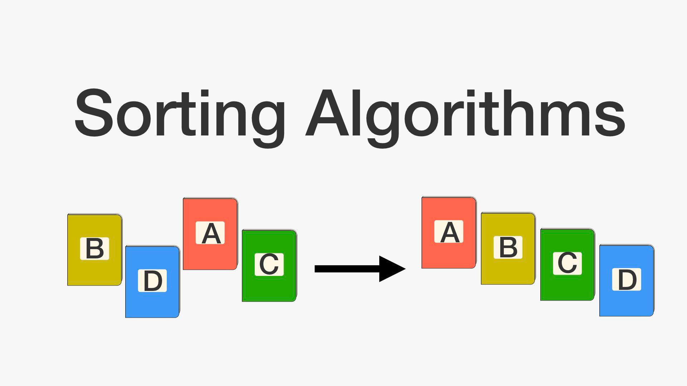

PROGRAM TO SORT ARRAY OF DATA IN DECREASING ORDER USING 8085
VANSHAJ KERNI
INT MSc PHYSICS III
PAGE 01

Slide 2

SORTING ALGORITHM
PAGE 02

Slide 3

A sorting algorithm is an algorithm that puts elements of a list in a certain order.
For example: Sorting lists of characters based on their ASCII values.
a,t,u,p,o,i,j a,i,j,o,p,t,u
PAGE 03

Slide 4
01
03
Bubble Sorting
Selection Sorting
02
04
Merge Sorting
Insertion sorting
PAGE 04

Slide 5

BUBBLE SORTING ALGORITHM
PAGE 04

Slide 6

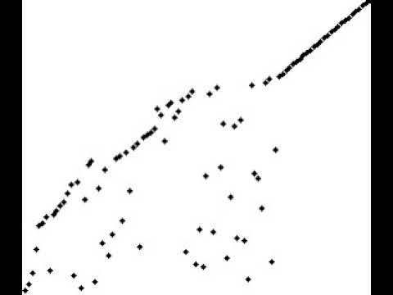
Bubble sort, sometimes referred to as sinking sort, is a simple sorting algorithm that repeatedly steps through the list, compares adjacent elements and swaps them if they are in the wrong order
PAGE 05

Slide 7
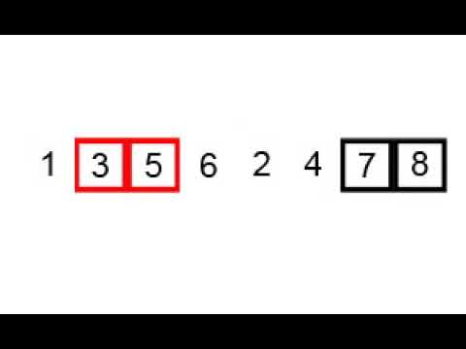

Slide 8

WORKING OF BUBBLE SORT IN GNUSims 8085 SIMULATOR
https://gnusim8085.srid.ca/download
PAGE 08

Slide 9
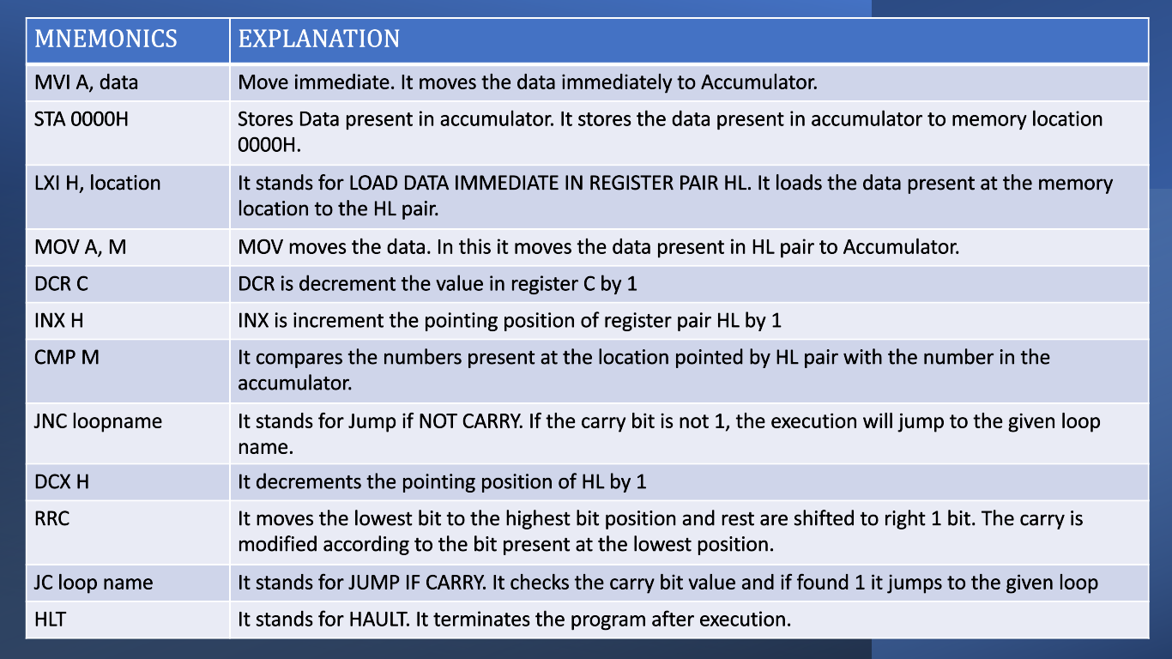
MNEMONICS
IN 8085
PAGE 09

Slide 10
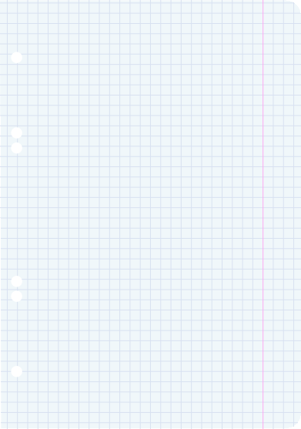
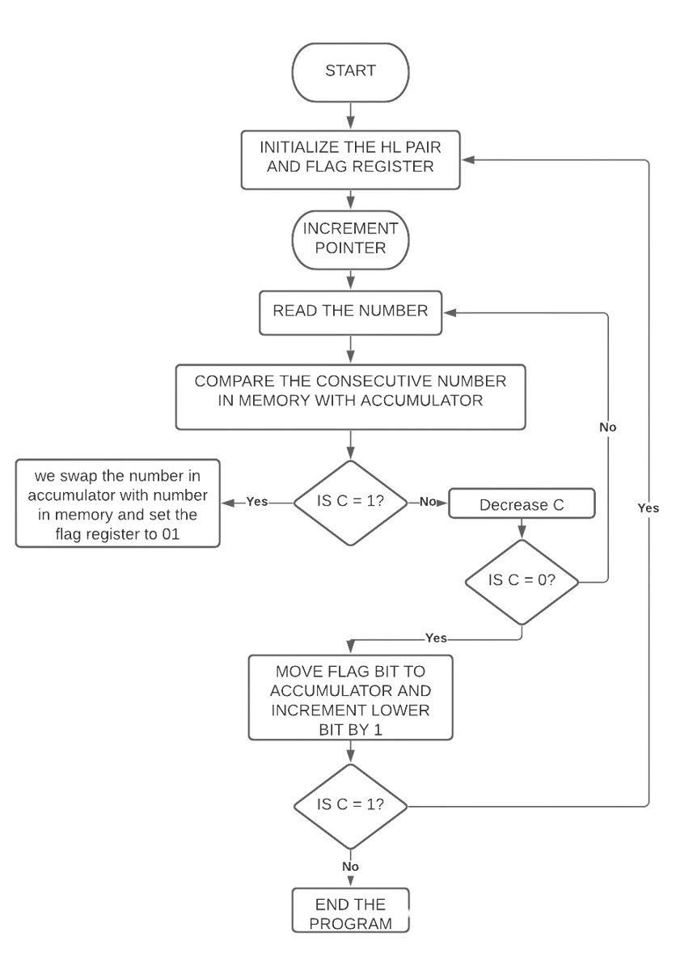
FLOW CHART FOR
BUBBLE SORT
IN 8085
PAGE 10

Slide 11

UNDERSTANDING BUBBLE SORTING MORE
PAGE 11

Slide 12
Bubble sorting:
O(n), O(n^2)
Inefficient
Exchanging
Slow compared to Mergesort method
Time complexity
Efficiency
Method of sorting
Speed of sorting
In 2007, former Google CEO Eric Schmidt asked then-presidential candidate Barack Obama during an interview about the best way to sort one million integers; Obama paused for a moment and replied "I think the bubble sort would be the wrong way to go."
PAGE 12

Slide 13


the code is available at:
PAGE 13

